Slide 1
An online marketplace connecting travelers with local hosts
190 countries < 34,000 cities
Entire Place or Private Room
Hosts & Travelers
Notes:
Airbnb is a popular online marketplace connecting travelers with local hosts.
Founded a decade ago, Aribnb functions as a hospitality service.
The demand in alternative hospice has attracted over 150 million users and expanded across 190 countries worldwide.
Airbnb has reshaped the way the world travels.
This peer-to-peer property rental service is comprised of two types of users: Hosts- which are property owners who list their entire place or private room; Travelers-who rent short-term lodging.
The types of properties listed vary widely, users can choose the privacy of renting an entire house or the affordability of a shared room.

Slide 2
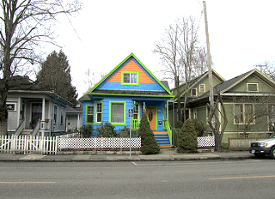
Hosting in Portland
Notes:
For this analysis, we narrowed the domain to a single city—the city of Portland, Oregon.
With the goal in identifying which factors are most influential in generating supplemental income as a host.
To discover underlying components we cross-referenced Inside Airbnb’s recently published data set concerning Airbnb listings within the Portland Metropolitan Area and with Portland neighborhood data made available through Monthly Portland Magazine’s website.

Slide 3
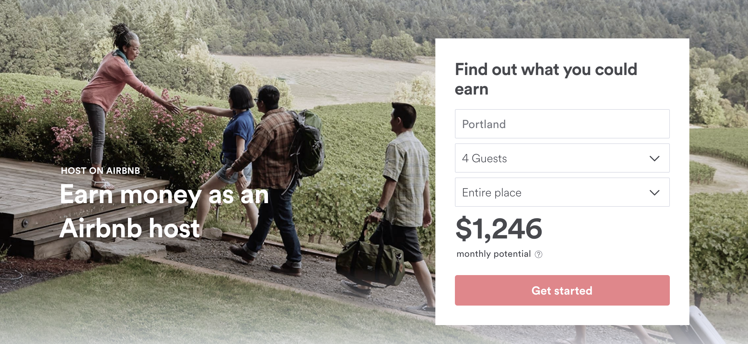
What is the earning potential for hosting in Portland?
What circumstances contribute to larger revenue?
Notes:
We decided to examine which factors influence nightly listing price on the Airbnb website and to try quantify the earnings potential of Aribnb hosts.

Slide 4
Do property values have an effect on pricing?
Notes:
Demographic data including information on real estate value and lifestyle factors
were used to analyze if there is any correlation to neighborhood listing price on Airbnb.

Slide 5
Any of these factors influence earnings?
Downtown
Crime
Parks
Notes:
Of particular interest, lifestyle and circumferential factors relating to commute, transportation and the accessibility of amenities such as public parks and crime rates were evaluated.

Slide 6
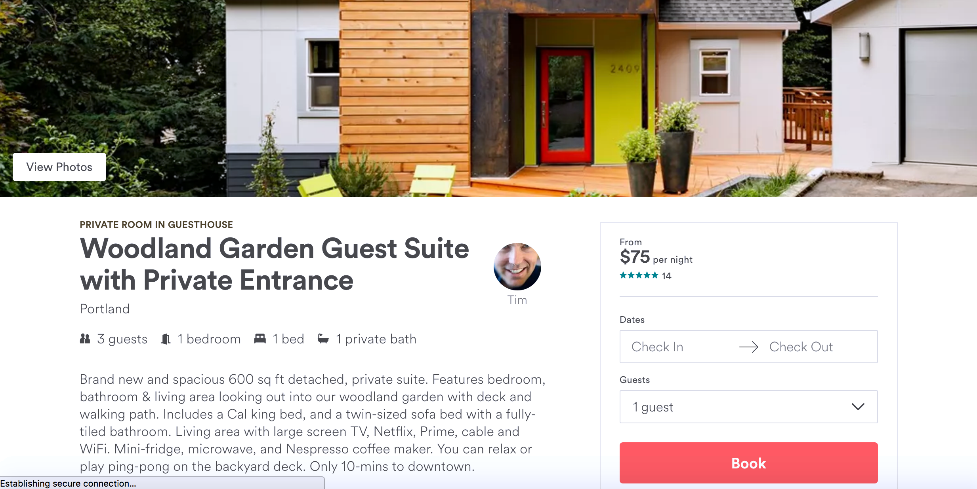
Instant Booking
Reviews
Ratings
What about other parameters about the host like:
Notes:
Airbnb listings included ratings such as the cleanliness of an accommodation, the total number of reviews, and the frequency of said reviews.
Instant booking is an optional feature that expedites the process by eliminating wait time in approval from hosts.

Slide 7
Property Values & Listing Pricing

Slide 8
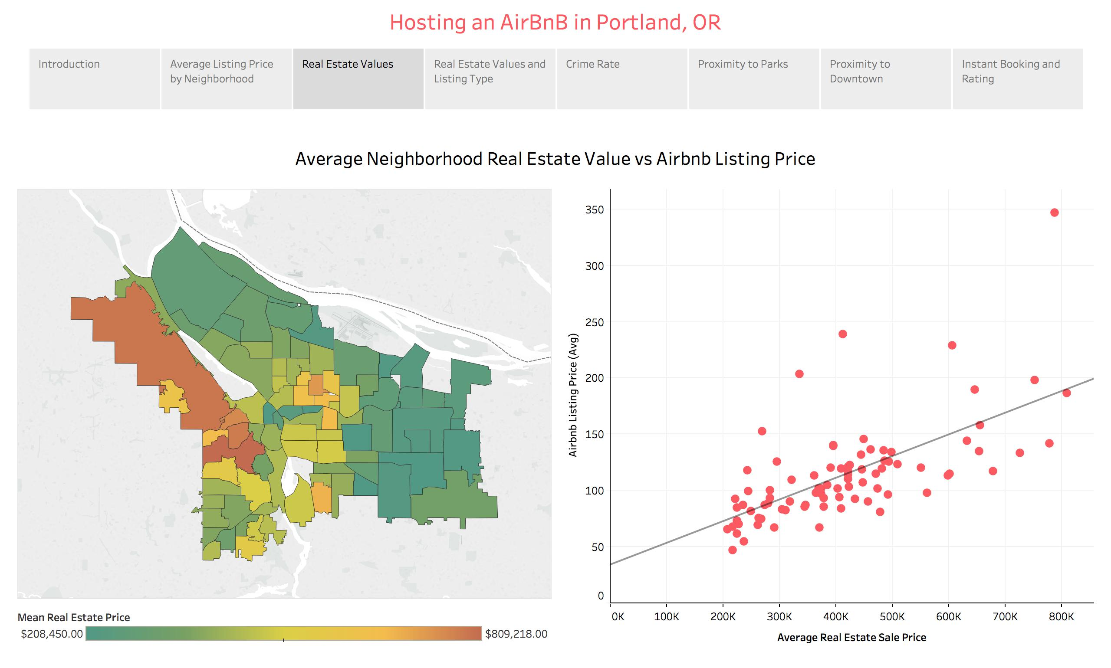

Slide 9
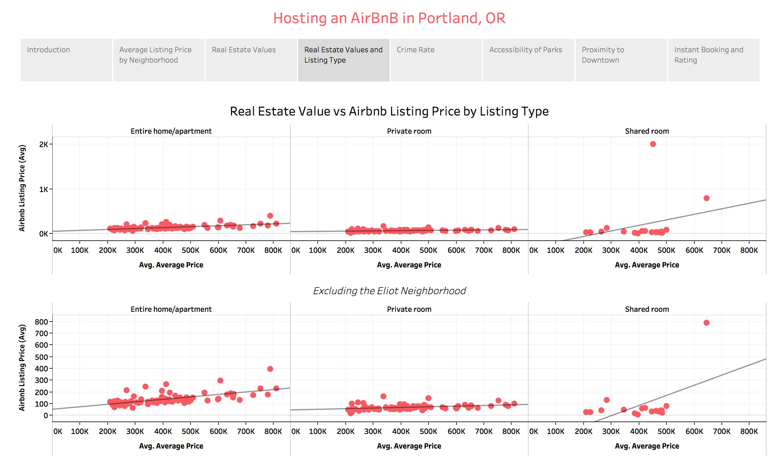

Slide 11
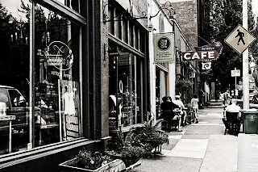
Proximity to Downtown Portland

Slide 12
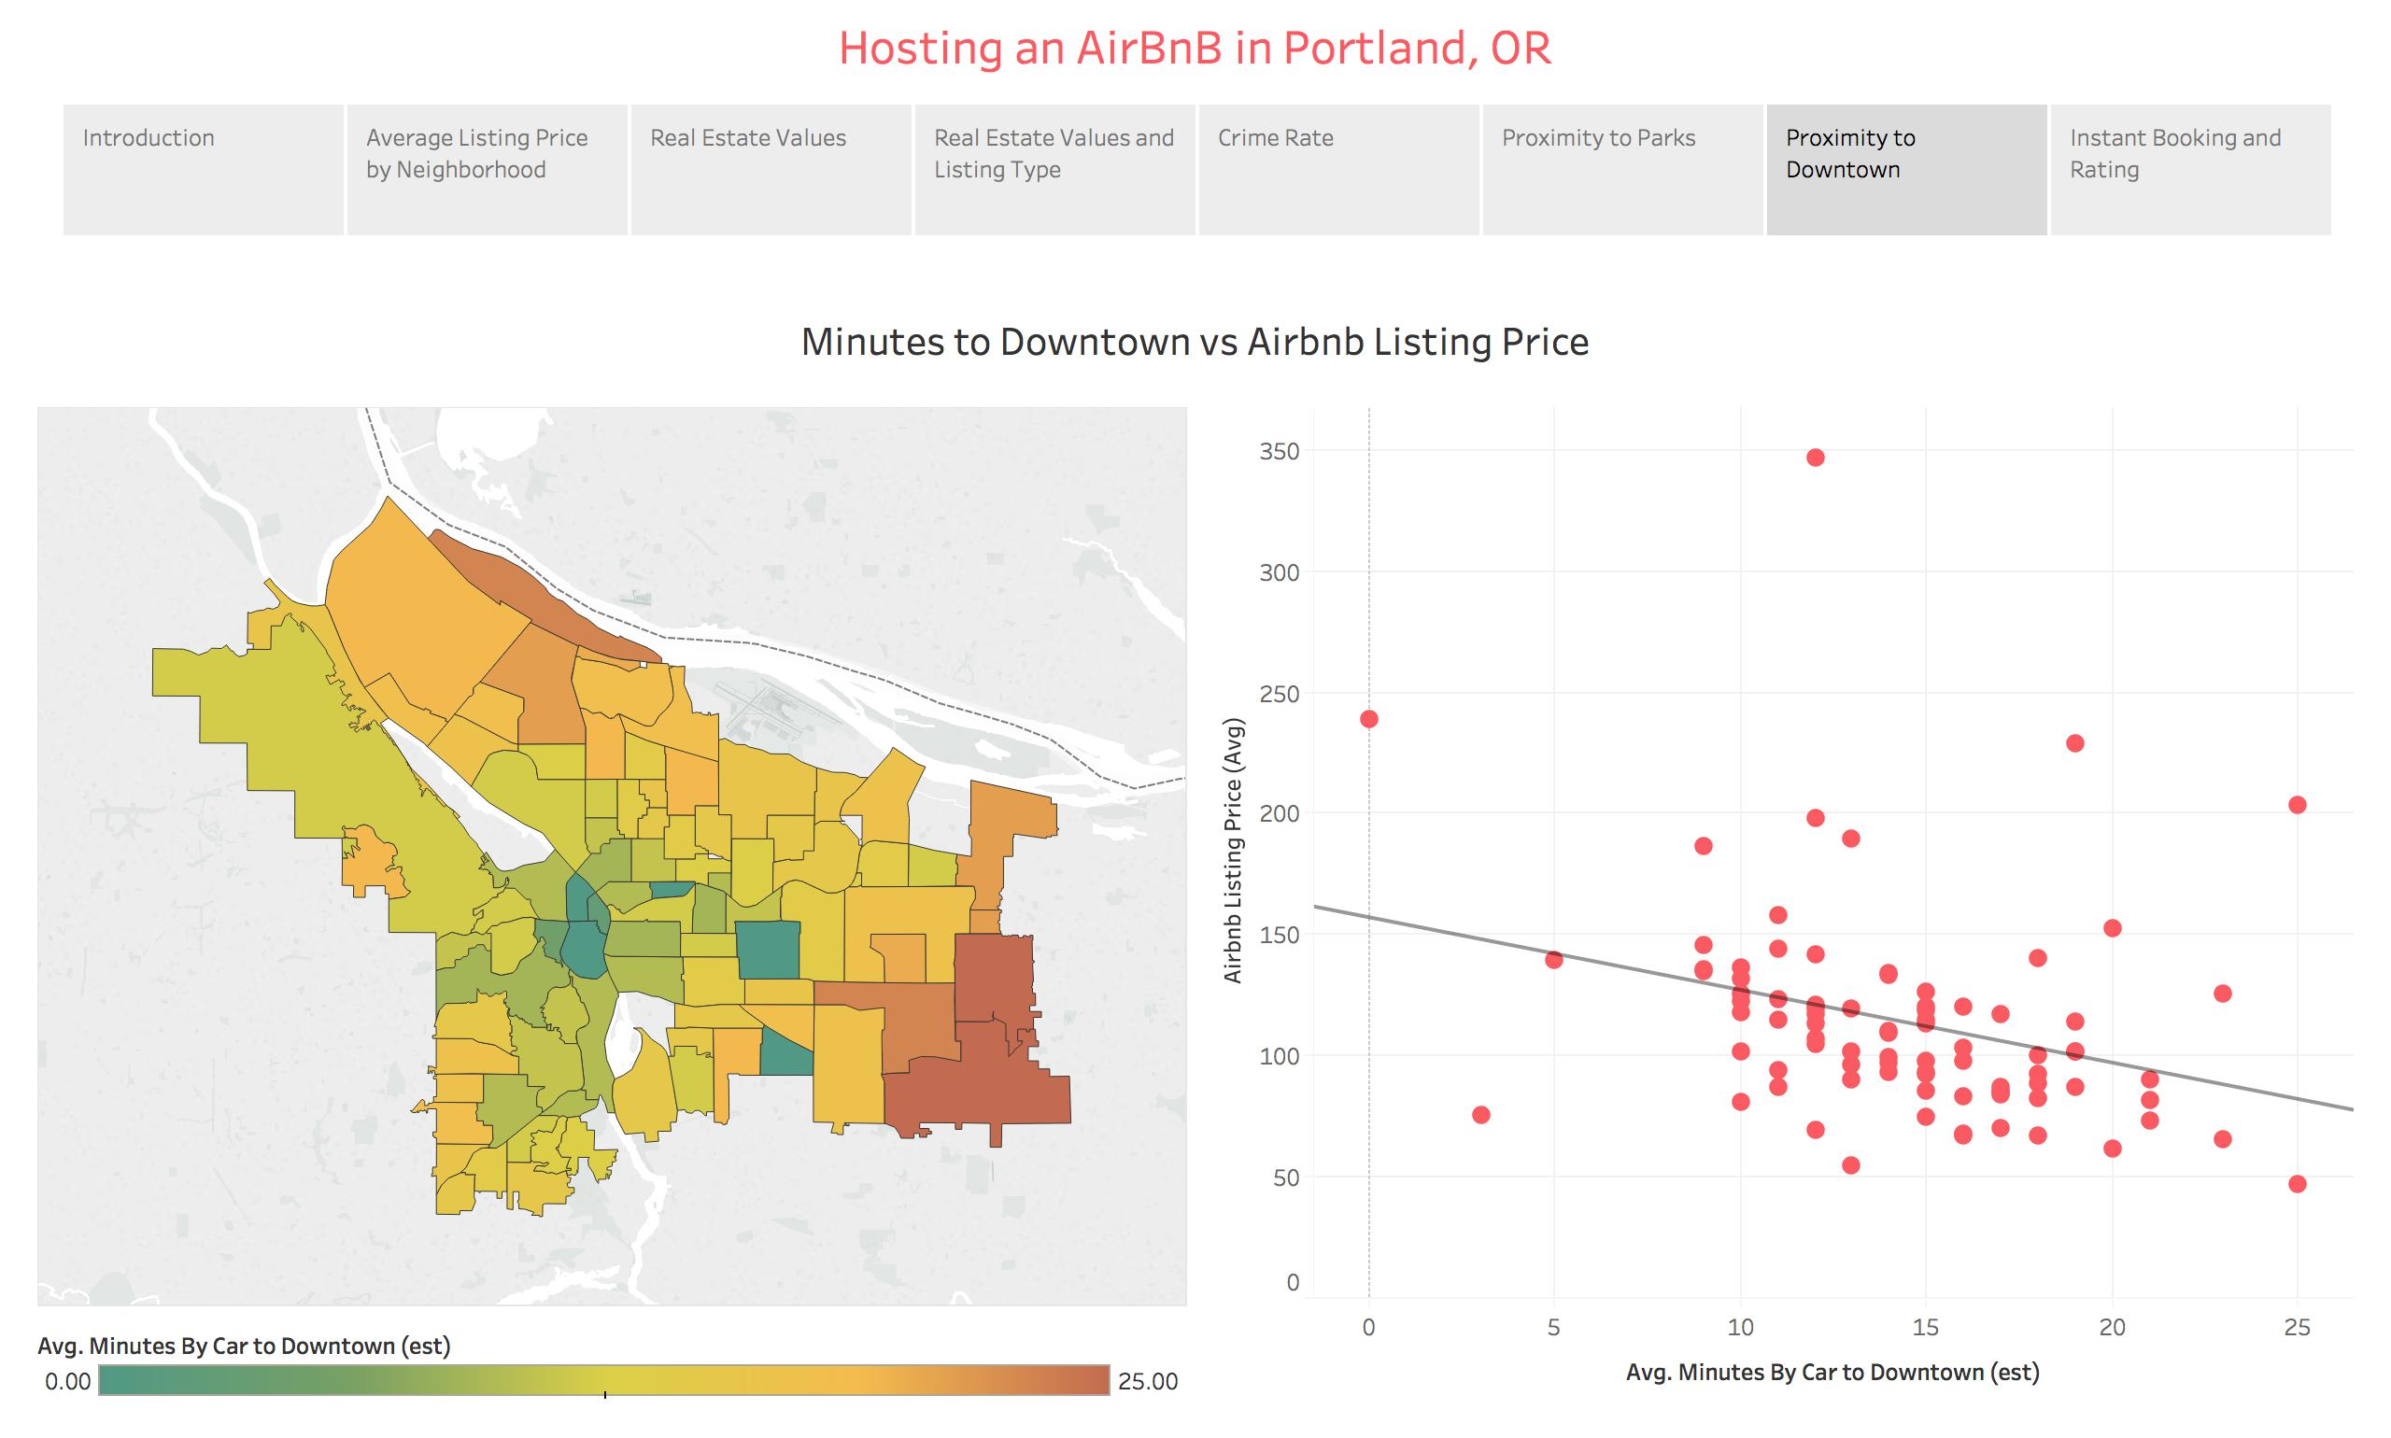

Slide 13
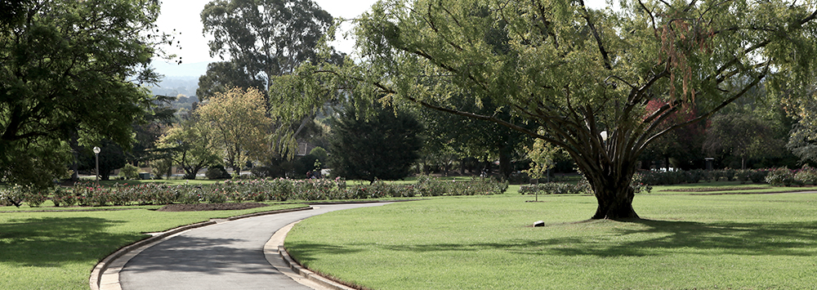
Accessibility to parks

Slide 14
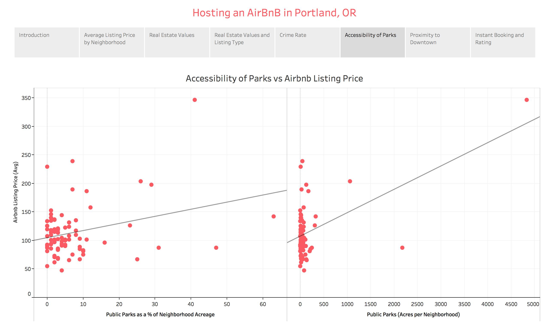

Slide 15
Crime Rate

Slide 16
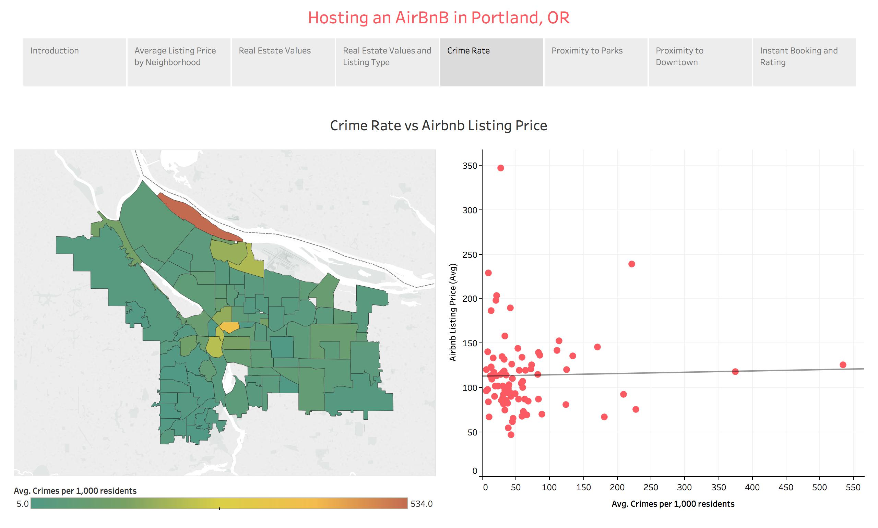

Slide 17
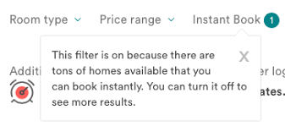
Instant Booking

Slide 18
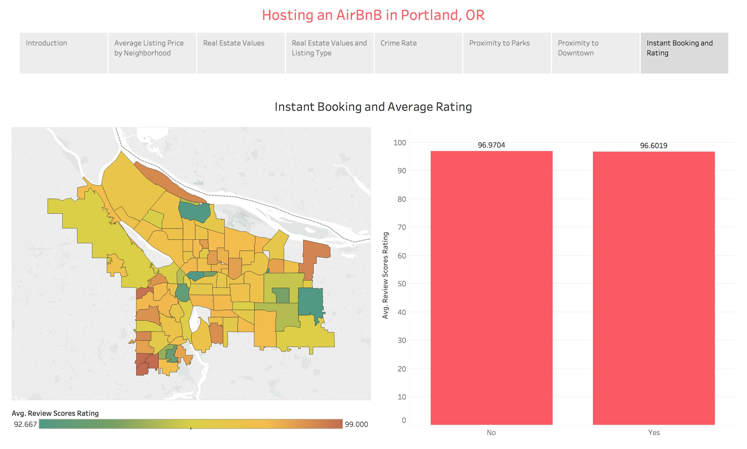
96.9704
96.6019

Slide 19
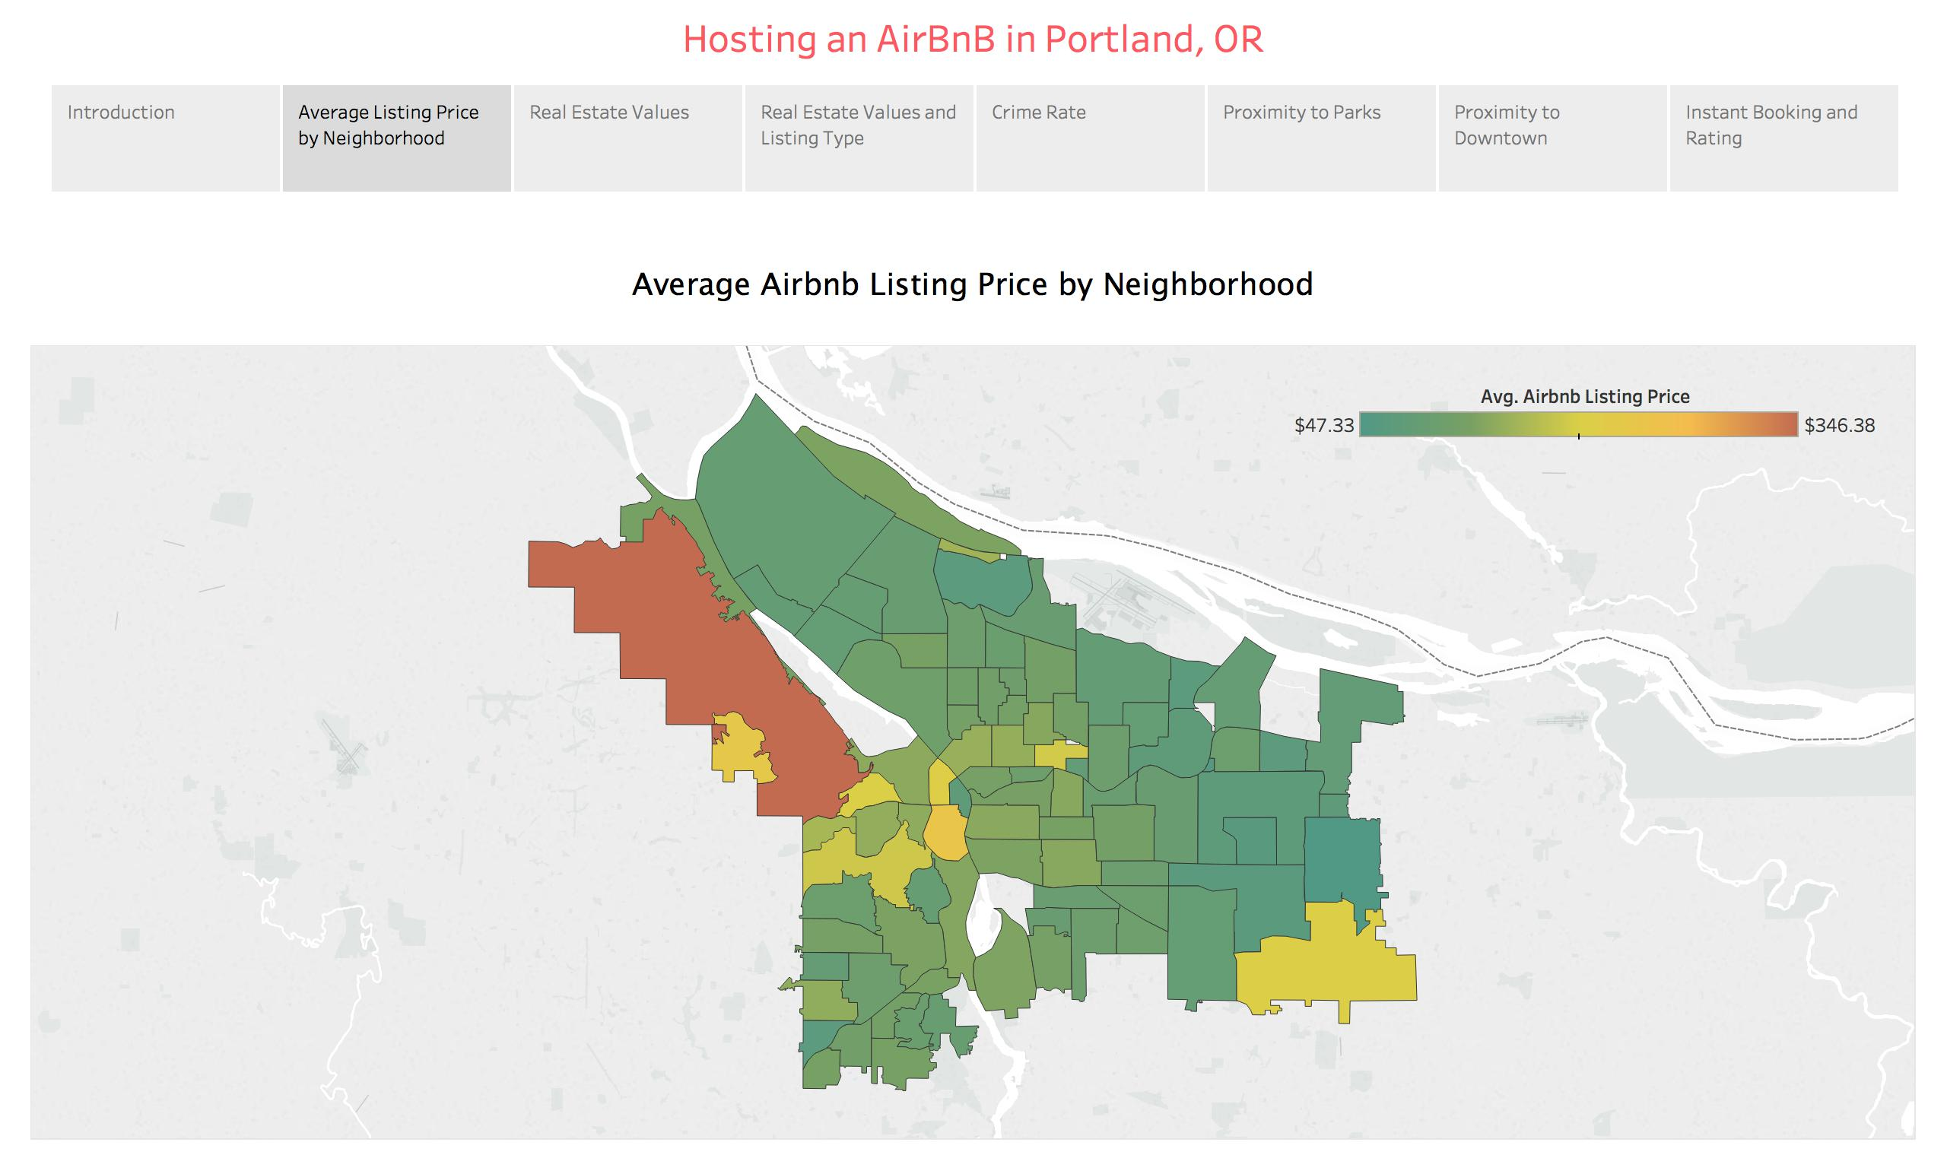
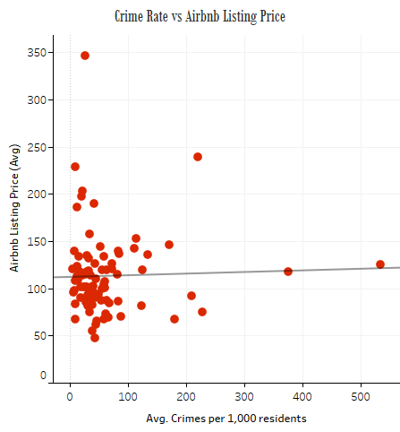
Design Process
Scatter Plot
Choropleth map
Interactive Vis: https://public.tableau.com/profile/alexa.goff#!/vizhome/final_182/Story1?publish=yes

Slide 20
Conclusion
Out of 5 factors studied for their influence on average listing price:
Moderate
Strong Relationship
Weak Relationships
Distance from Downtown
Access to Parks
No Statistical Correlation
Crime
Instant Booking
Real Estate Value
https://public.tableau.com/profile/alexa.goff#!/vizhome/final_182/Story1?publish=yes

Slide 21
References
Airbnb (2018, May 4). Airbnb unveils top 10 most hospitable cities in the U.S.. Retrieved from https://press.atairbnb.com/airbnb-unveils-top-10-most-hospitable-cities-in-the-us/
Bort, J. (2018, February 6). Airbnb made $93 million in profit on $2.6 billion in revenue, but an internal clash sent the CFO out the door. Retrieved from http://www.businessinsider.com/airbnb-profit-revenue-2018-2
Carson, B. (2016, February 15). How 3 guys turned renting an air mattress in their apartment into a $25 billion company. Retrieved from http://www.businessinsider.com/how-airbnb-was-founded-a-visual-history-2016-2
City of Portland, Oregon Open Data. (2018, January 5). Neighborhoods (regions). Retrieved from https://gis-pdx.opendata.arcgis.com/datasets/neighborhoods-regions
DeNies, R., & Stanton, S., (2016, April 1). Portland neighborhoods by the numbers 2016: The city. Portland Monthly. Retrieved from: https://www.pdxmonthly.com/articles/2016/4/1/real-estate-2016-the-city
Jasper. (2015, September 18). The Airbnb founder story: From selling cereals to a $25b company. Retrieved from https://getpaidforyourpad.com/blog/the-airbnb-founder-story/
Marum, A. (2018, January 8). Downtown Portland’s paradox: Crime, public perceptions threaten growth, retailers say. Retrieved from http://www.oregonlive.com/business/index.ssf/2018/01/downtown_portlands_paradox.html
Murray, C. (2018, February 8). Get the data. Retrieved from http://insideairbnb.com/get-the-data.html
Pullen, J.P. (2017, January 3). Forest Park: Escape the city without leaving Portland in this massive urban wilderness that’s a haven for animals and adventurers alike. Retrieved from https://www.travelportland.com/article/forest-park
Robinson, A.H., Morrison, J.L., Muehrke, P.C., Kimmerling, A.J. & Guptill, S.C. (1995). Elements of Cartography. New York: Wiley.
Segel, E., & Heer, J. (2010). Narrative visualization: Telling stories with data. IEEE Transactions on Visualization and Computer Graphics, 16(6), 1139-1148. Retrieved from http://vis.stanford.edu/files/2010-Narrative-InfoVis.pdf
Smith, C. (2018, May 8). 100 Airbnb statistics and facts (March 2018): By the numbers. https://expandedramblings.com/index.php/airbnb-statistics/

