Slide 1
Fresno County Public Library Organizational Analysis
Laura Chumas
Angela Dabrowski
Jennifer Frey
Michelle Peralta
Jason Sue
Yer Vang
Brenda Williams
San Jose State University
INFO 204-12, Fall 2016
Professor Robert Boyd, J.D.

Slide 2
Part 1: Mission, Vision, & Value Statements Environmental Scan and SWOT Analysis

Slide 3
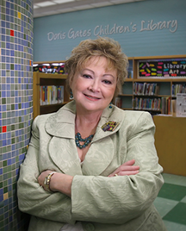
FRESNO COUNTY PUBLIC LIBRARY
STRATEGIC PLAN

Slide 4
About the Fresno County Public Library
The Fresno County Public Library serves a large area located in the San Joaquin Valley through it’s Central Resource Library and 34 branches.
The library is part of a cooperative network of 10 public library jurisdictions called the San Joaquin Valley Library System that serve Fresno, Kern, Kings, Madera, Mariposa, Merced, and Tulare counties.
The Fresno County Public Library encourages an environment focused on community, learning opportunities, and access to quality resources through programming.

Slide 5
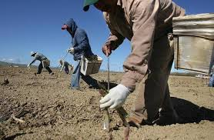
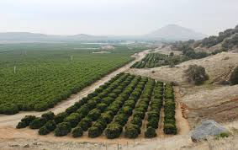
Population Demographics & Economy
According to 2010 census information compiled by the Stanford Center on Longevity and California State Library, Fresno County’s population is comprised of the following:
Hispanics –50%
White – 33%
Asian – 10%
African American – 5%
Age of Population
19-32 (196,108 persons)
46-64 (187,956 persons)
33-45 (146,663 persons)
San Joaquin Valley has a large farming community, which support nearly 20% of all jobs in the county. Other jobs in the county include government positions, education and health service positions, and trade, transportation, and utilities positions. The civilian labor force makes up approximately 61% of the population in Fresno and of this percentage 55% are female.

Slide 6
MISSION STATEMENT
The Fresno County Public Library is committed to servicing this community and sees its mission as providing an environment that enables community connections, lifelong learning opportunities, and enrichment through creative programs and access to quality resources.

Slide 7
VISION STATEMENT
The vision of the Fresno County Public Library is to provide relevant technology which cultivates learning and enhances the lives of our diverse community. Through our qualified and creative librarians and staff, we will offer engaging and dynamic programs to encourage personal learning and community development. Within the facilities of our main library and thirty-four branches, we will create a safe environment and communal gathering place that fosters inclusivity and conversation.

Slide 8
FOUR CORE VALUES
SERVICE
FREEDOM
COLLABORATION
INCLUSION

Slide 9
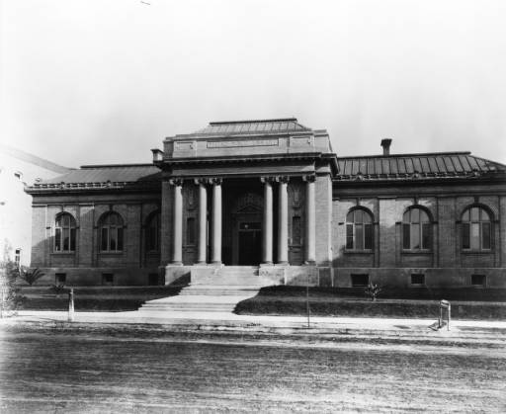
Environmental Scan: History
1893 – Fresno City Library
1904 – Carnegie Foundation
1910 – Fresno County Public Library
1917 – Fresno County Library system
Carnegie Library in Fresno, CA circa 1910. University of Southern California Libraries and the California Historical Society.

Slide 10
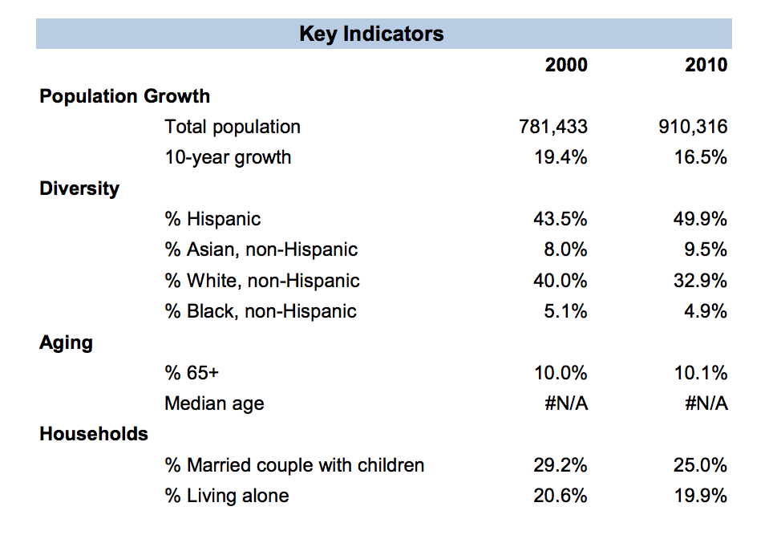
Environmental Scan: Demographics
Demographic profile, Fresno County Public Library. (2010). Stanford Center on Longevity. Retrieved from https://www.library.ca.gov/lds/demographicprofiles/docs-jurisdiction/Fresno%20County%20Public%20Library%20DP2010.pdf

Slide 11
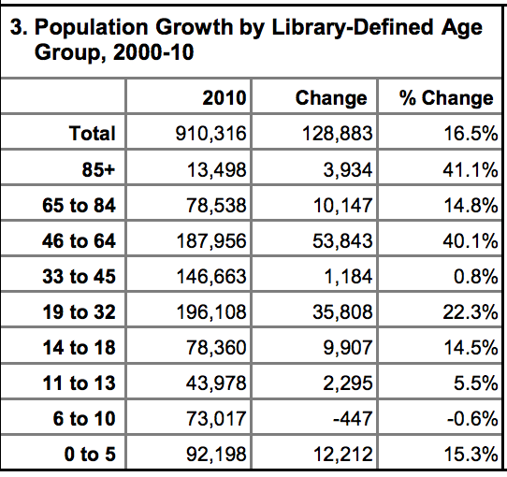
Environmental Scan: Demographics
Demographic profile, Fresno County Public Library. (2010). Stanford Center on Longevity. Retrieved from https://www.library.ca.gov/lds/demographicprofiles/docs-jurisdiction/Fresno%20County%20Public%20Library%20DP2010.pdf

Slide 12
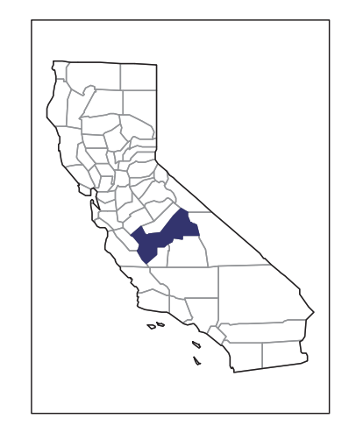
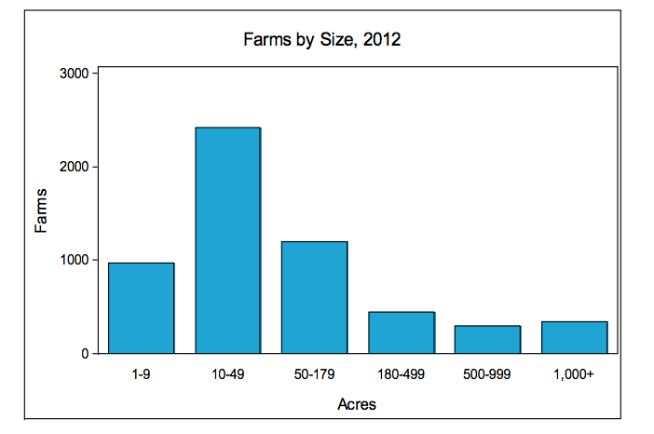
Environmental Scan: Economy
Census of agriculture, Fresno county profile. (2012). United States Department of Agriculture.
Retrieved from
https://www.agcensus.usda.gov/Publications/2012/Online_Resources/County_Profiles/Ca
lifornia/cp06019.pdf

Slide 13
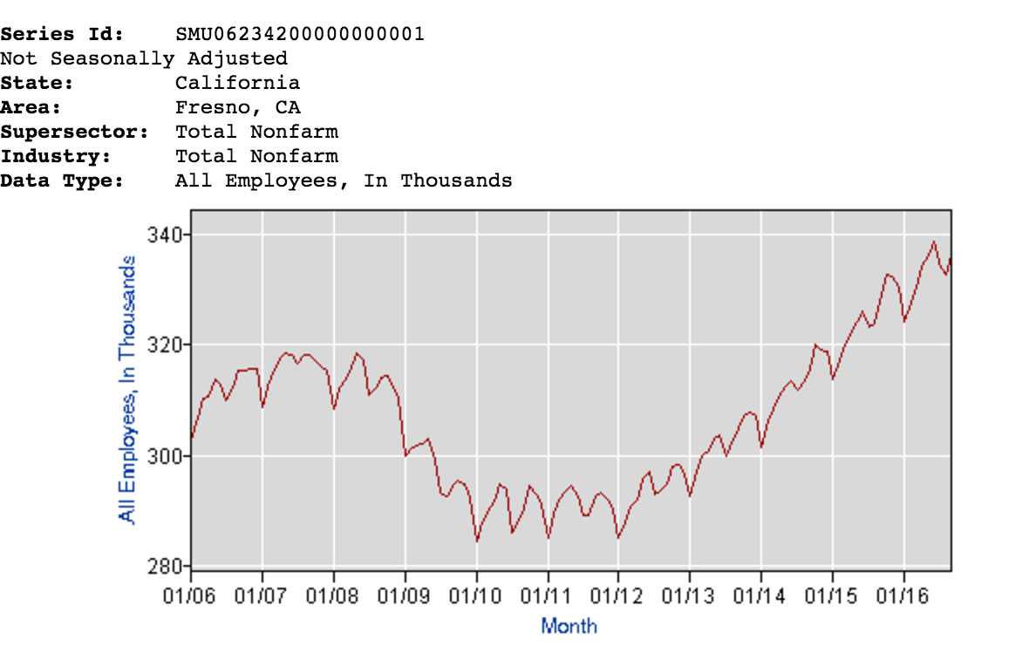
Environmental Scan: Economy
Quick Facts Fresno County California. (2015). United States Census Bureau. Retrieved from http://www.census.gov/quickfacts/table/PST045215/06019

Slide 14
SWOT Analysis

Slide 15
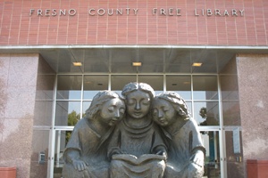
SWOT: Strengths

Slide 16
Greatest Contributions
The San Joaquin Valley Library System (SJVLS)
The California History and Genealogy Room
The AprendoVan
The Community Bookmobile
The WoW (WithOut Walls) program
Notes:
There have been several wonderful contributions of the Fresno County Public Library since the library opened its door to the public in February 1, 1892. Some of the greatest contributions are: the San Joaquin Valley System, the California History and Genealogy Room, the AprendoVan, the Community Bookmobile, and the WoW program.

Slide 17
The San Joaquin Valley Library System (SJVLS)
Previously known as the San Joaquin Valley Reference Project (SJVRP) in the late 1950s.
Received financial support from the federal Library Services Act
There were a team of five (two librarians and three clerks) established at the Fresno Central branch.
The SJVRP Project became the first cooperative reference system in California in May 1960.
The SJVRP Project modified its name San Joaquin Valley Information System (SJVIS), then changed its name to San Joaquin Valley Library System (SJVLS).
Notes:
The San Joaquin Valley Library System started off as the San Joaquin Valley Reference Project in the late 1950’s. The program received financial support from the federal Library Services Act to answer challenging and comprehensive questions. The first initial team was established at the Fresno Central Branch. The team consisted of five people: two librarians and three library clerks. The SJVRP Project was the first cooperative reference system in California. The project modified its name a couple of times to San Joaquin Valley Information System (SJVIS), then changed it to San Joaquin Valley Library System (SJVLS).

Slide 18
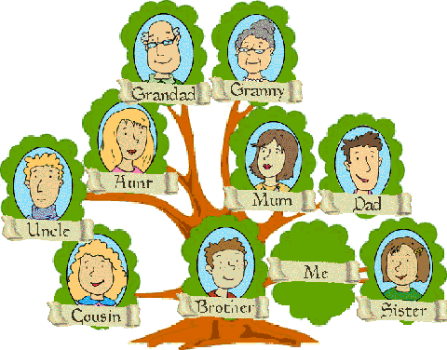
The California History and Genealogy Room
The California History Room started with Helen Pierson (a reference librarian) in 1954 at the Central Branch.
She specialized in the area of local history.
She maintained a card index of articles appearing in the Fresno Bee.
Her method of card cataloging became very useful to the public.
Mrs. Pierson retired from the Reference Department in 1967.
The San Joaquin Valley Heritage & Genealogy Center was created in 1993 as a cooperative effort of the Fresno County Public Library and the Fresno County Genealogical Society.
Total holdings consist of approximately 30,000 books and pamphlets, 5,000 microforms, 300 CD-ROMs, and many other types of research materials.
Notes:
Helen Pierson started the California History Room at the Central Branch in 1954. Pierson was a reference librarian who specialized in local history. While working at the Central Branch, Pierson maintained a card index of articles that appeared in the Fresno Bee. Her method of card cataloging became very useful to the public. Mrs. Pierson retired from the Reference Department in 1967.
Moving on to the San Joaquin Valley Heritage & Genealogy Center, which was created in 1993 as a cooperative effort of the Fresno County Public Library and the Fresno County Genealogical Society. The San Joaquin Valley Heritage & Genealogy Center occupy the same space as the California History Room. There are approximately 30,000 books and pamphlets, 5,000 microfilms, 300 CD-ROMs and other types of research materials in the room.

Slide 19
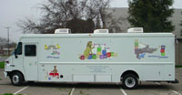
The AprendoVan
Known as “Biblioteca Ambulante”.
Came on board as a Spanish language-oriented service on December 1, 1968 with roughly 30 percent of its materials in Spanish.
The program was funded through federal funds for the expansion and enhancement of library services.
Staff assigned to this program must be bilingual.
Provided services to these areas: Tranquillity, San Joaquin, Five Points, Halfway, Oro Loma, Cantua Creek, Head Start, Home Base Head Start, Migrant Head Start, Day Care facilities in Mendota.
Notes:
The AprendoVan was also known as “Biblioteca Ambulante”. It came on board as a Spanish language-oriented service on December 1, 1968. About 30 percent of its materials are in Spanish. The program was funded through federal funds to enhance and expand library services. The AprendoVan required one library staff only and the staff must be bilingual.

Slide 20
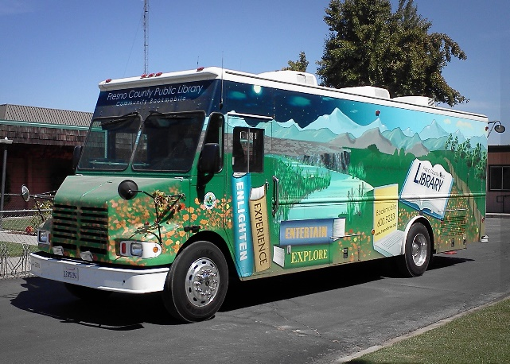
The Community Bookmobile
Built by the Gerstenslager Company of Wooster, Ohio to transport a total of 3,500 books to rural areas
Presented on April 16, 1962 to Fresno County residents.
Provided services to: Heritage-East ADHCC, Friant Post Office, Raisin City, Dunlap, Five Points, Monroe Elementary School, Del Rey, Manchester Mall, Heritage-West ADHCC, and Victoria West Community Park
Notes:
The first Community Bookmobile was built by the Gerstenslager Company of Wooster, Ohio. The bookmobile was presented on April 16, 1962. It carried a total of 3,500 books to rural areas of Fresno County.

Slide 21
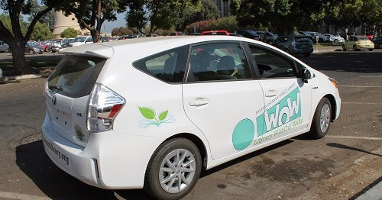
The WoW (WithOut Walls) program
The only program of its kind in the Central Valley.
This mobile library provide services for the entire community residing in the areas of Fresno County.
WoW program involves Community Librarians, who focuses on community outreach.
WoW Librarians connect with nonprofits and businesses to inform and demonstrate what resources are available through the libraries and its website.
A highlight of the program is the Citizenship Corner, led by Michelle Gordon, a Community Librarian.
She collaborates with the United States Citizenship and Immigration Services (USCIS) to expand the Citizenship Corner in other Fresno County branches.
Notes:
The WoW program is the only program of its kind in the Central Valley. This mobile library provide services for the entire community in Fresno County. The program involves Community Librarians who focuses on community outreach such as nonprofits, businesses, schools, and community events. A highlight of the program is the Citizenship Corner, led by a Community Librarian name Michelle Gordon. She collaborates with the United States Citizenship and Immigration Services to expand the Citizenship Corner in other Fresno County branches.

Slide 22
SWOT: Weaknesses
Needs of our community who are not fluent in English.
Programs for the infant to 18-month age group.
Parking at the Central Library branch.

Slide 23
SWOT: Opportunities
ALA Current Trends:
Internet of Things
Makerspaces

Slide 24
SWOT: Opportunities
Utilizing regional resources:
Job Training
Collaborating with local businesses
Sierra National Forrest

Slide 25
SWOT: THREATS
TERRORISM/MASS SHOOTINGS
In a world where terrorism and mass-shootings have increased, any public gathering place could be considered at-risk. If there was an attack on the library, it could have a lasting negative effect since the attack could scare patrons, and fewer people would come to the library as a result.

Slide 26
THREATS (CONTINUED)
GLOBAL WARMING
Fresno County is a large agricultural community, because of this global warming is a threat to the library. The library looks for support from community members for funding.
If a natural disaster should hit the library directly, this could negatively impact the collection housed in the library.

Slide 27
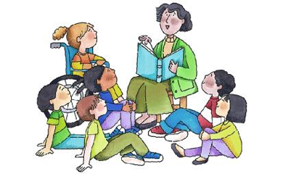
STORYTIMES
One service that has threatened the library’s success is story-times since they have been haphazardly done across the entire system.

Slide 28
LOSS OF PUBLIC SUPPORT
The public is the libraries greatest strength so to lose their support would be the greatest threat of all. Measure B, makes up over half of the Fresno County Public Library’s funding.
Without the public's approval of Measure B the library would have difficulty maintaining even the most basic library services.

Slide 29
Part 2: Strategic Plan

Slide 30
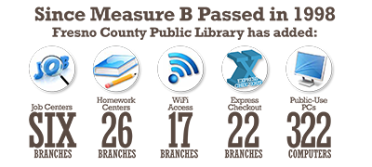
Goal 1 Develop a marketing plan that targets Measure B programs and services to show taxpayers how their tax dollars are benefiting their community and to provide promotion of said services and programs.
Improvements to Library Programs & Services Because of Measure B

Slide 31
Objective: Create a general marketing plan to promote services and programs paid for by Measure B funds
Demonstrate value to community, board of supervisors, the public, and the Measure B Citizens Review Panel
Action Plan: Two annual events hosted by the library to highlight programs and services paid for by Measure B funds and to thank the public for supporting the library through tax dollars.
Assessment: Library opinion poll/survey at the end of the year to determine user satisfaction, assess our performance, evaluate our programs and services and customer satisfaction to guide future programs and services.

Slide 32
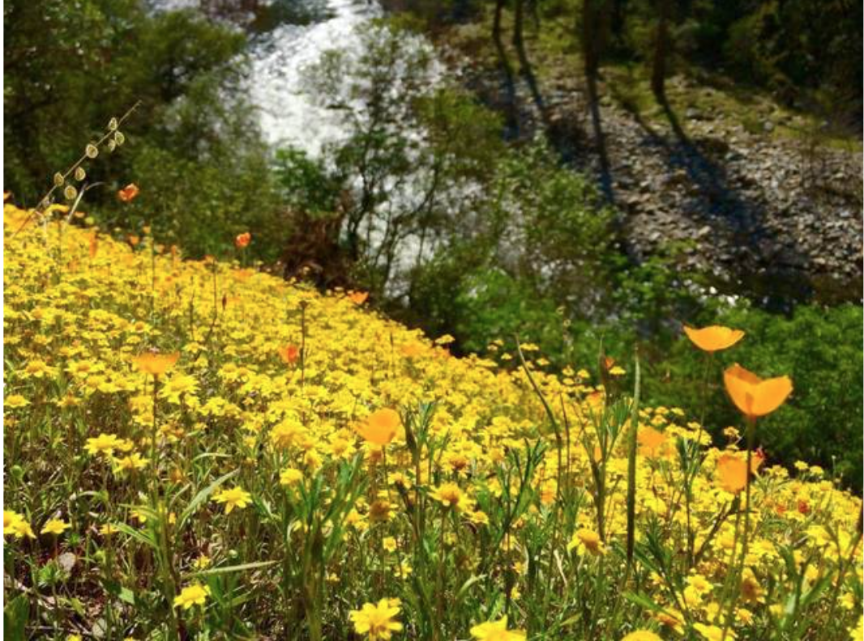
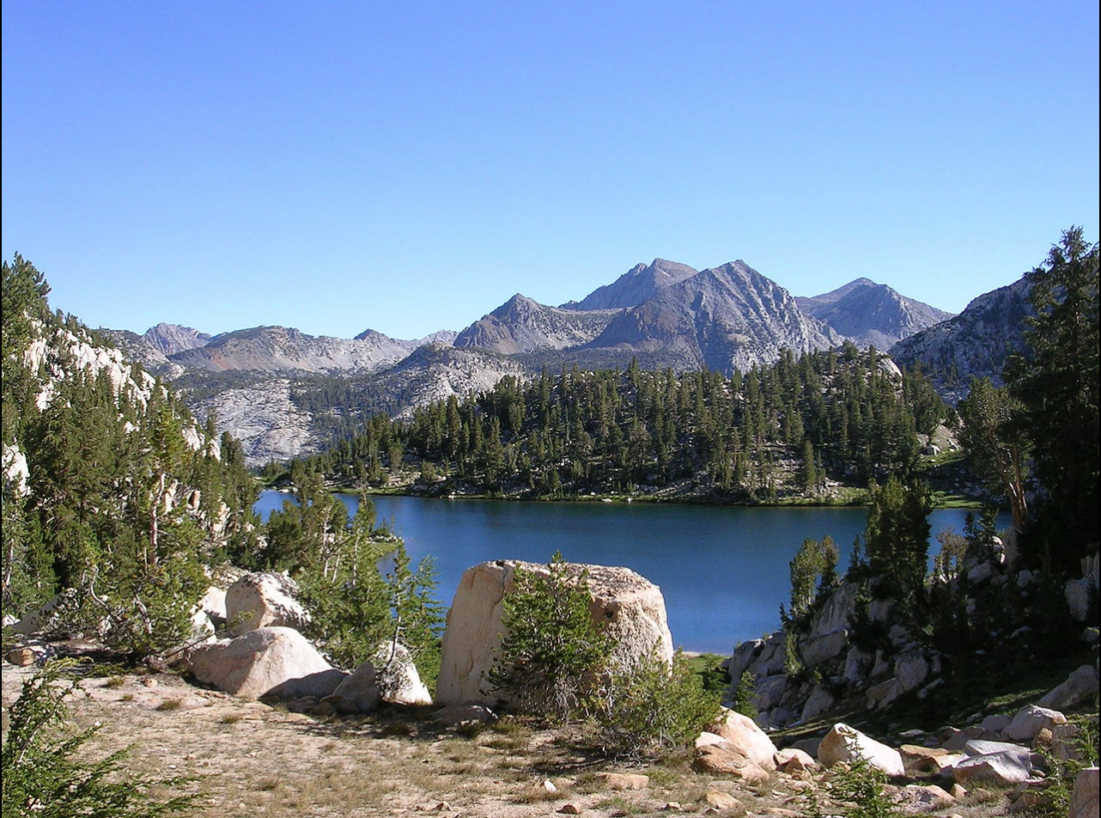
Goal 2 collaborate with educational and cultural organizations to enrich community experiences
Objective:
Collaborate with the
Sierra National Forest

Slide 33
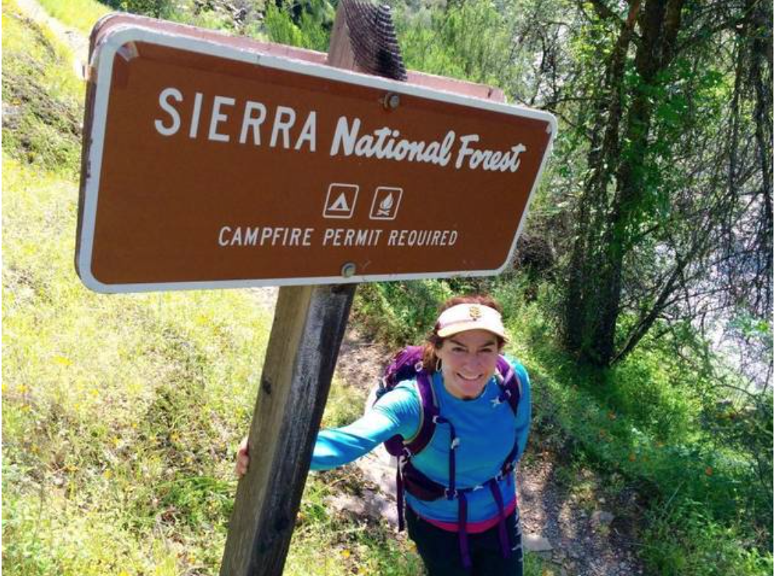
Action Plan:
Highlight Library Content
Displays
Programming

Slide 34
GOAL 3 CONNECTING WITH NON-ENGLISH COMMUNITY

Slide 35
National Literacy Partnership
Weekly day & evening classes

Slide 36
Establish a network of volunteers
Partnerships with local institutions
Collection Development

Slide 37
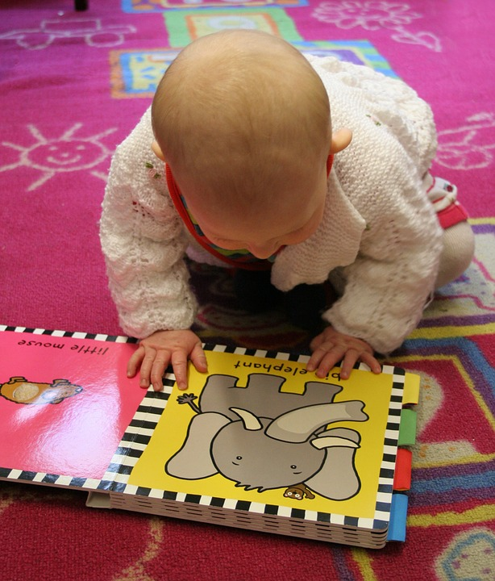
GOAL 4 Fill the Void in Programs Available to the Infant to 18-Month Age Group

Slide 38
GOAL 4 (CONTINUED)
OBJECTIVES:
Teach adults more about the importance of early literacy.
Nurture pre-reading skills in infants.
Promote resources and services the library offers.
Encourage early childhood reading, literacy and language skills.
Offer a supportive environment that encourages meaningful social interactions.

Slide 39
GOAL 4 (CONTINUED)
ACTION PLAN:
Add a 30 minute weekly program that uses the Babies Need Words Every Day Campaign & book list for ideas.
Create a display of books from the booklist & promotional posters so parents and caregivers will have easy access to materials to bring home.
Greet patrons & show the different resources and services offered at the library.
Invite everyone to mingle with each other and let their children play after. Use the talking points provided through the Babies Need Words Campaign to continue to educate.

Slide 40
GOAL 4 (CONTINUED)
ASSESSMENT:
Track the number of books circulating that are part of the Babies Need Words Everyday Campaign.
Count how many children and how many adults attend the program each week and track its growth on a spreadsheet.
The spreadsheet will have room for comments each week so any feedback or suggestions given by participants or others involved in this programming will be recorded.

Slide 41
Goal 5 Emergency Procedures

Slide 42
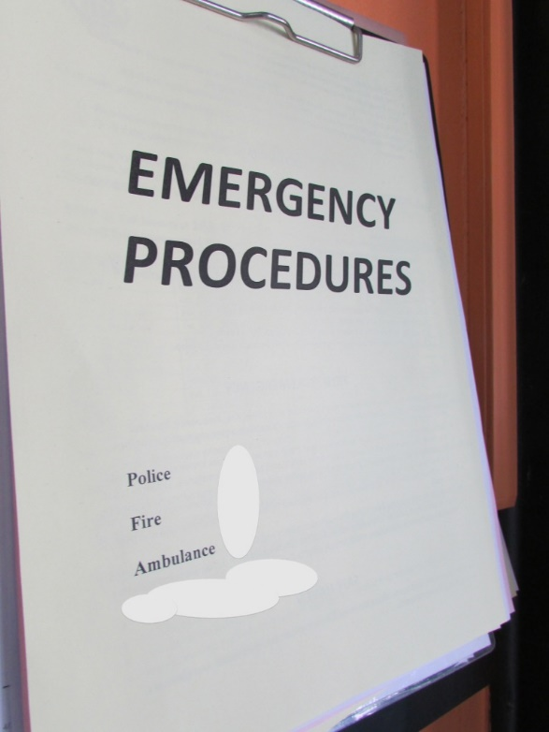
Objective: Develop emergency procedures and an evacuation plan to train all library staff for emergency circumstances.
Action Plans for Unforeseen Emergencies
Accidents/Serious Injury
Fire
Bomb Threat(s)
Earthquake(s)
Notes:
Here are some action plans for unforeseen emergencies such as accidents and/or serious injury, fire, bomb threat, and earthquake.

Slide 43
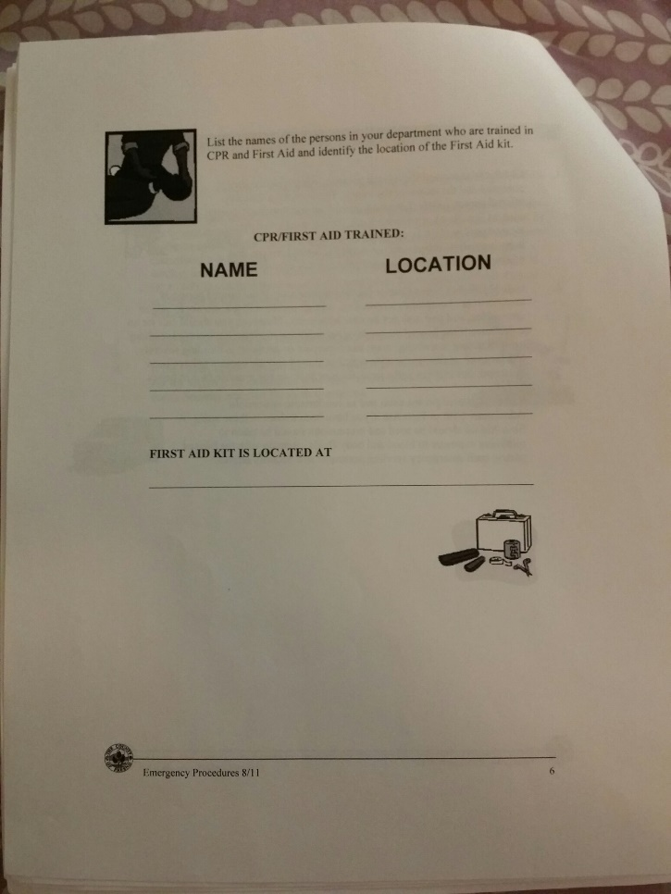
Accidents/Serious Injury
Inspect the area and the injured person to determine the possible danger and the extent of the injury. Do not move an injured person unless he or she is in imminent danger such as fire, flood, or poisonous gas. If you must move the injured person, do it quickly and cautiously as possible to a safe area. Advise the bystanders not to touch or move the injured person.
Call 911 immediately if the injured person is unconscious or ask a staff to call if you are unable to. Whether the person is conscious or unconscious, it is best to call for an ambulance to ensure the condition of the injured person.
Administer CPR or First Aid only if you or a staff are trained in these areas. A First Aid Kit should be easy to locate and used to minimize exposure of blood and body fluids. Try to keep the injured person calm and comfortable as much as possible. Remain with the injured person at all times if possible until emergency services arrives.
Notes:
Step 1: When responding to an accident and/or serious injury, you must inspect the area and the injured person to see if he or she is near any dangerous chemicals, fire, or flood. If the injured person is in danger, then remove him or her quickly and cautiously to a safe place. If the injured person is not in danger, please do not remove him or her from the area. Make sure to advise any bystanders not to touch or remove the injured person.
Step 2: Immediately call 911. Whether the person is conscious or unconscious, it is best to call for an ambulance to ensure the condition of the person.
Step 3: Only administer CPR or First Aid if you are trained, otherwise try to keep the injured person calm and comfortable. Remain with the injured person at all times until the ambulance have arrived.

Slide 44
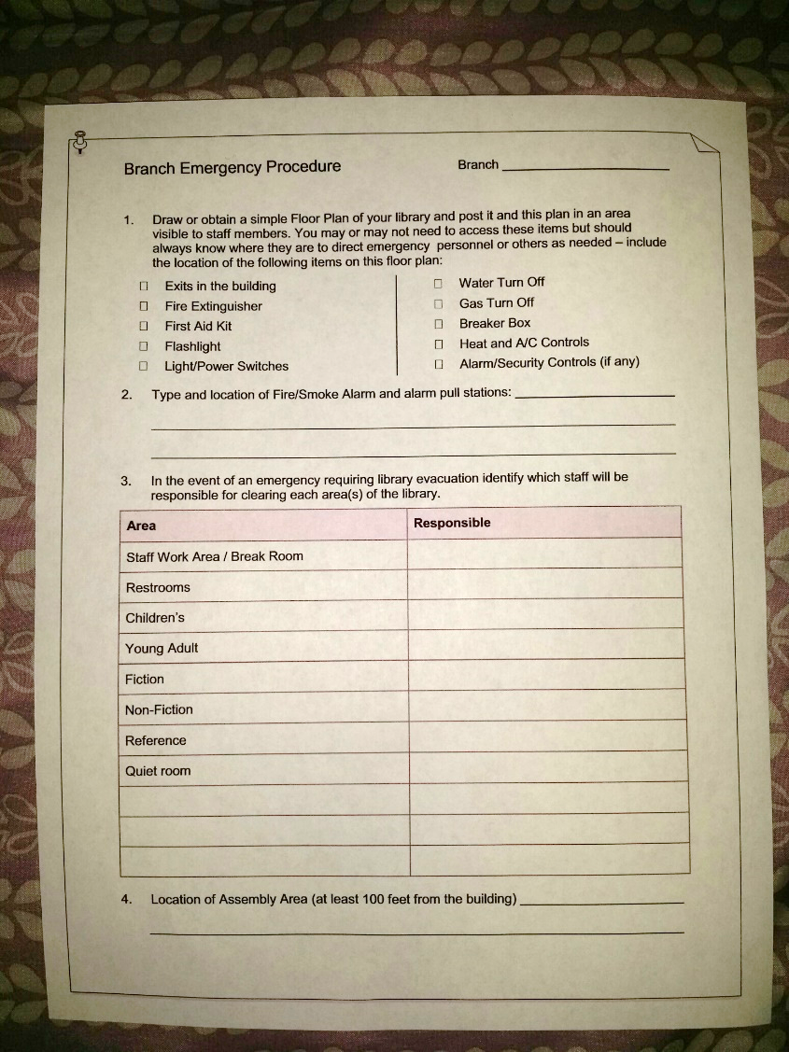
Fire
Try to evacuate or remove anyone in immediate danger. Then locate the fire alarm and activate it.
Call 911. If available, announce on the intercom to evacuate all staff and patrons in the building.
Locate the fire extinguisher and attempt to extinguish the fire if you have received proper training on the use of a fire extinguisher.
Advise all staff and patrons not to use the elevator(s) when the fire alarm has been sounded.
Staff who are disabled and unable to walk should request assistance from those nearest them. If no one is available to provide assistance, continue to the closest stairway and shout for help.
Be sure to advise Fire Department of staff who are trapped on a floor or may require assistance to evacuate.

Slide 45
Bomb Threat(s)
If you receive a bomb threat or discover a possible bomb or suspicious object(s), immediately notify your supervisor or manager, security (if available), or the Sheriff’s Dispatch Center at 600-3111. Then your supervisor or manager should immediately notify the Department Head about the situation.

Slide 46
Bomb Threat(s) continued…
Bomb threat received by phone:
Attempt to get a staff’s attention and express the nature of the call. Have the staff disseminate the information to a supervisor or manager to contact Sheriff’s Dispatch Center at 600-3111 and the Department Head.
While on the phone, attempt to retrieve the following information:
Where is the bomb?
When is it going to explode?
What does it look like?
What kind of bomb is it?
What is the person’s name or organization?
Make sure to record the phone conversation:
Date and time of call
Exact words of the caller
Age, sex, adult or child
Any speech pattern
Background noises
Notes:
If you received a bomb threat by phone, try to get a staff’s attention and express the nature of the call. Have the staff disseminate the information to a supervisor or manager to contact the Sheriff’s Dispatch Center.
While you are on the phone, try to get as much information as you can by asking the following:
Last but not least, make sure to record the your phone conversation with the caller.

Slide 47
Earthquake(s)
If you are indoors when an earthquake occurs, stay inside and locate the nearest desk, table or doorway to take shelter. If you cannot locate something durable or stand in the doorway, get on your hands and knees then cover your head with your hands and arms.
If you are in building with floor levels, stay away from the windows, light fixtures, filing cabinets, and bookshelves. Do not attempt to use the elevator, instead locate the nearest desk, table or doorway.
If you are outdoors when an earthquake occurs, locate an open area away from trees, building, walls, roadways, and power lines.
If you are driving, pull to the side of the road, stop and remain in your vehicle until the earthquake has stopped. Avoid stopping under overpasses, electrical powerlines, light posts or sign posts.
Notes:
Indoors: If you happen to be inside a building during an earthquake, make sure to remain indoor and locate the nearest desk, table or doorway to use for shelter. If you cannot find something durable or find a doorway, get on you hands and knees then cover you head with your hands and arms. Remember to stay away from the windows, light fixtures, filing cabinets, and bookshelves. Do not try to use the elevator during an earthquake.
Outdoors: If you happen to be outside during an earthquake, find a safe area away from trees, buildings, walls, roadways, and powerlines. If you are driving while an earthquake is happening, make sure to find a safe area and pull to the side of the road. Remain in your car until the earthquake has stopped. Remember not to park under overpasses or near electrical powerlines, light posts or sign posts.

Slide 48
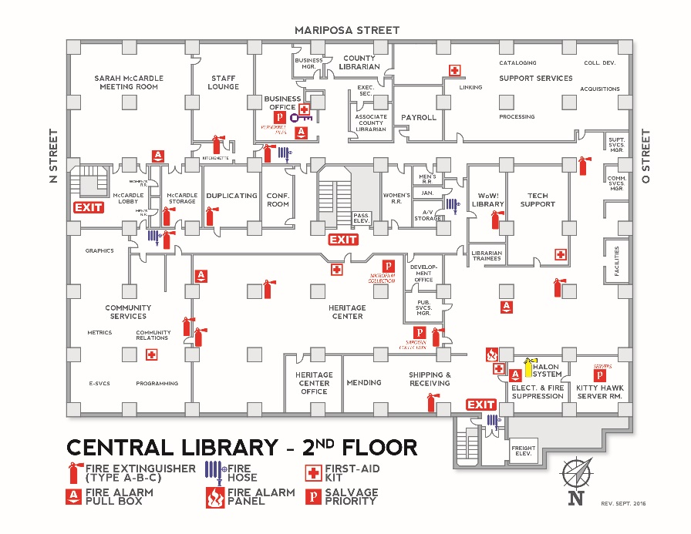
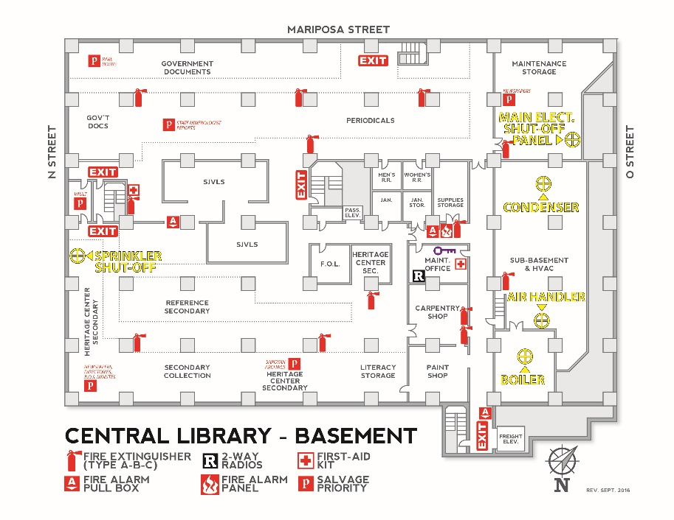
Map of Fresno Central Library
Notes:
Here is a map of the Fresno County Central Library. As you can see, Central Library is a two story building with a basement. Staff can use this map as a guide to locate: first aid kit, fire extinguisher, fire hose, fire alarm panel, and fire alarm pull box.

Slide 49
Notes:
Now the question is “Will you be prepared when disaster hits?”

Slide 50
Goal 6
Respect and celebrate the diversity of our experiences and the cultural heritage of the community we serve by striving for inclusivity in our programs and services.

Slide 51
6.1 Develop a collection development plan that reflects the interests and needs of the library’s diverse populations.
Survey local cultural organizations and leaders
Develop collection development plan for books/resources to be implemented across all library departments

Slide 52
6.2 Provide diverse programming and services that promote learning and understanding between and among the library’s diverse populations.
Survey local cultural organizations and leaders
Implement inclusionary programs such as book clubs, story-telling events, and other “high impact” programming

Slide 53
6.3 Develop a cultural competency plan for the library staff that supports diversity efforts
Library-wide culturally competency assessment
Provide workshops and resources
Create committees and encourage participation among all staff
Create fora/talks from community cultural organizations

Slide 54
Goal 7
To forge a material connection between the Fresno County Public Library and the community of senior citizens.

Slide 55
Objectives
Create senior spaces for the elderly to gather.
Offer programming tailored to the elderly demographic.
Expand and promote the collections of materials usable to people of poor eyesight.
Forge material connections with the senior community through outreach.

Slide 56
Action Plan (Senior Spaces)
Variety of Furniture with Wheel Chair Accessibility
Periodicals, Audiobooks, and Large Print Collection
Bulletin Board and Displays
Notes:
To provide for comfort and accessibility, senior spaces should be outfitted with a variety of furniture including wheel chair assessable tables.
In addition, periodicals, audiobooks, and the large print collection should be moved into or adjacent to these senior spaces.
Senior spaces should also have a bulletin board allowing for the posting of events and services of interest to seniors as well as displays of library materials on a topic of interest to the elderly such as Your Health, Your Retirement.

Slide 57
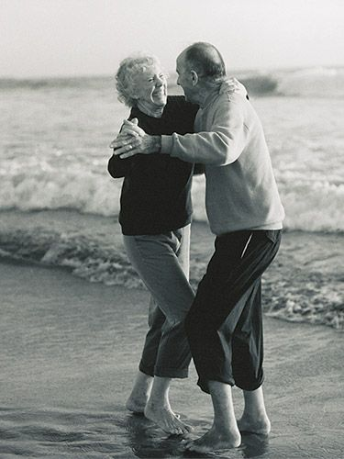
Action Plan (Programming)
Low Impact Exercises
Hobbies and Social Clubs
Pinochle and Bridge
Waltz and Swing Dancing
Book Clubs
Technology
Senior Video Game Night
Computer Literacy Classes
Notes:
To attract seniors to the library, librarians should expand the number of low impact exercise sessions such as Tai Chi.
In addition, the library should also host activities and sponsor social clubs such as Pinochle and Bridge sessions, waltz and swing dancing and book clubs.
The Fresno Library should also expand its computer literacy classes and host Senior Video Game Nights—modeling them after the success of other libraries.

Slide 58
Action Plan (Library Materials)
Audiobooks in Storage
Easy for Person’s of Poor Eyesight
Increases Diversity of Collection
Large Print in Storage
Easy for Person’s of Poor Eyesight
Increases Diversity of Collection
E-books on Overdrive
Overdrive Literacy Workshops
Employing Training
Notes:
The elderly often depend on either audiobooks or books in large print. Current shelf space of either collection is inadequate to match the diversity of standard printed materials. To remedy this shortcoming the Fresno County Library should create a section of “audtiobooks in storage” and “large print materials in storage” to be available upon request.
To assist the elderly with e-books, the Fresno Library should host Overdrive Literacy Workshops.
The library should also train its employees in the nuances of Overdrive in order to provide better service to the customer in regards to e books

Slide 59
Action Plan (Outreach)
Senior Pop-Up Library
Functions as a Book Mobile
Capacity of 650 Items
Increase the Hours and Locations
Books by Mail Program
Increase Maximum Items from 3 to 5.
Include DVD’s in the Program
Emphasize in Outreach to Hospitals and Hospices
Notes:
The Senior Pop-Up Library with a capacity of 650 items functions as a book mobile by making regular stops at large senior centers. We propose to increase its operating hours allowing for the Senior Pop Up Library to service more locations and further expand the library’s outreach to senior citizens.
For those retirees who live independently, they have the option of using the Books by Mail Program to borrow library books, in order to increase usage of library materials, we recommend that the Fresno Library increase the maximum items from 3 to 5. include DVD’s in the program and emphasize the Books by Mail Program during outreach to hospitals and hospices.

Slide 60
Conclusion
Fresno County Public Library is a valued resource to the community.
Through continual reassessment, the library will continue to remain a relevant and inspiring resource.

